Slide 1
Data structures
Dr. Rachid EL KHOURY
Lebanese University
1

Slide 2
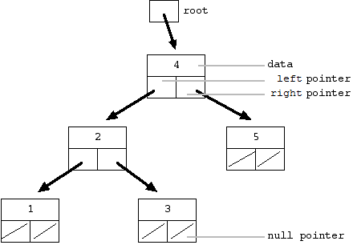
General Introduction to Data Structures
A data structure is a scheme for organizing data in the memory of a computer.
Some of the more commonly used data structures include lists, arrays, stacks, queues, trees, and graphs.
2

Slide 3
General Introduction to Data Structures
The way in which the data is organized affects the performance of a program for different tasks.
Computer programmers decide which data structures to use based on the nature of the data and the processes that need to be performed on that data.
3

Slide 4
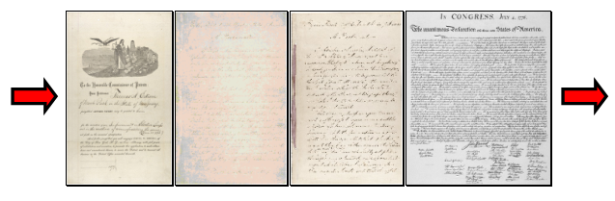
An example of data
A queue is an example of commonly used simple data structure. A queue has beginning and end, called the front and back of the queue.
Data enters the queue at one end and leaves at the other. Because of this, data exits the queue in the same order in which it enters the queue, like people in a checkout line at a supermarket.
A queue is a good data structure to use for storing things that need to be kept in order, such as a set of documents waiting to be printed on a network printer.
4

Slide 5
What's the point?
We are in a transition period from paper and hard copies to digital data (very important for students who want to continue as researchers)
To test the algorithms and their efficiencies (example in the next slide)
Caution! Very simple algorithms can be extremely difficult to analyze. for example problem of Syracuse
5

Slide 6
Efficiency comparison of two algorithms
Suppose n=10⁶ numbers and c: the cost function
  Insertion sort: c₁n²
  Merge sort: c₂n (lg n)
  Best programmer (c₁=2), machine language, one billion/second computer A.
  Bad programmer (c₂=50), high-language, ten million/second computer B.
  2 (10⁶)² instructions/10⁹ instructions per second = 2000 seconds.
  50 (10⁶ lg 10⁶) instructions/10⁷ instructions per second ≈ 100 seconds.
  Thus, merge sort on B is 20 times faster than insertion sort on A!
  If sorting ten million numbers, 2.3 days VS. 20 minutes.
Conclusions:
  Algorithms for solving the same problem can differ dramatically in their efficiency.
  much more significant than the differences due to hardware and software.
6

Slide 7
Syracuse Problem
Syracuse algorithm or 3x+1 problem
while n > 1
do : if n is even, then n := n/2 else n := 3n + 1
Example Number 6
6->3->10->5->16->8->4->2->1
It is an unsolved problem. This is true for all n <2 ^ 62 (January 2008 - T. Oliveira e Silva), which is more than four trillion of trillion! But is it true for all n?
7

Slide 8
Global Outline
Ch1-2: Analysis of Algorithms (introduction to programming) (2seances)
Ch3: Switch if while array…(2seances)
Ch4: functions(1seances)
Ch5: structure_pointer(2seances)
Ch6: intro to classes(2seances)
Ch7: More about classes(4seances)
Ch8: linked lists(2seances)
Ch9: Stack, Queue(2seances)
Ch10: Binary_tree(2seances)
Ch11: AvlTree(1seance)
Ch12: RedBlackTree(1seance)
Ch13: heaps(1seances)
Ch14:hashing,searching(1seance)
Ch15: sorting(1seance) (revision 1seance)
8

Slide 9
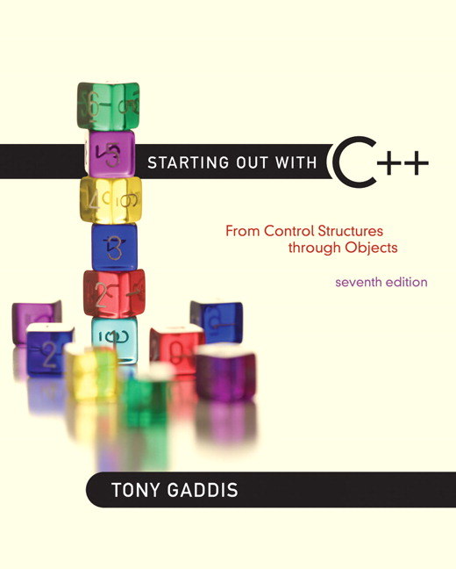

Chapter 1:
Introduction to Computers and Programming

Slide 10
1.1
Why Program?

Slide 11
Why Program?
Computer – programmable machine designed to follow instructions
Program – instructions in computer memory to make it do something
Programmer – person who writes instructions (programs) to make computer perform a task
SO, without programmers, no programs; without programs, a computer cannot do anything

Slide 12
1.2
Computer Systems: Hardware and Software

Slide 13
Main Hardware Component Categories:
Central Processing Unit (CPU)
Main Memory
Secondary Memory / Storage
Input Devices
Output Devices

Slide 14
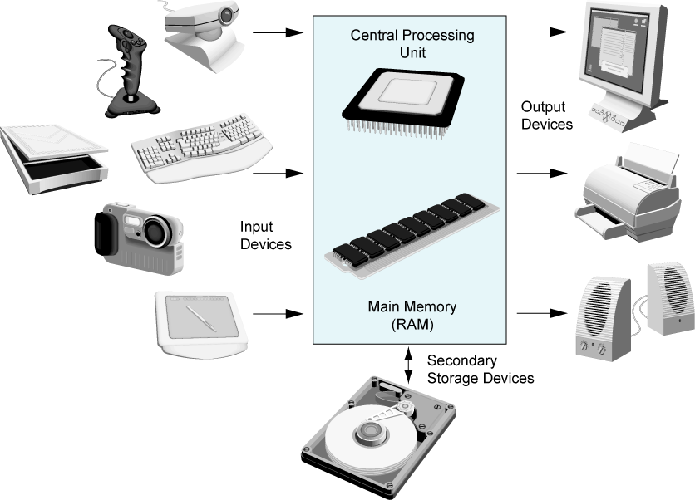
Main Hardware Component Categories
Figure 1-2

Slide 15
Central Processing Unit (CPU)
Comprised of:
  Control Unit
    Retrieves and decodes program instructions
    Coordinates activities of all other parts of computer
  Arithmetic & Logic Unit
    Hardware optimized for high-speed numeric calculation
    Hardware designed for true/false, yes/no decisions

Slide 16
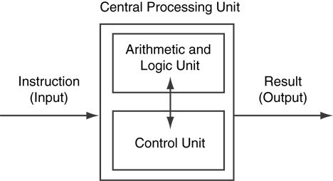
CPU Organization
Figure 1-3

Slide 17
Main Memory
It is volatile. Main memory is erased when program terminates or computer is turned off
Also called Random Access Memory (RAM)
Organized as follows:
  bit: smallest piece of memory. Has values 0 (off, false) or 1 (on, true)
  byte: 8 consecutive bits. Bytes have addresses.

Slide 18
Main Memory
Addresses – Each byte in memory is identified by a unique number known as an address.

Slide 19
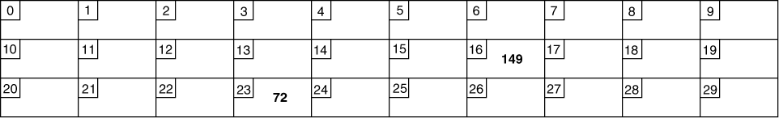
Main Memory
In Figure 1-4, the number 149 is stored in the byte with the address 16, and the number 72 is stored at address 23.

Slide 20
Secondary Storage
Non-volatile: data retained when program is not running or computer is turned off
Comes in a variety of media:
  magnetic: floppy disk, hard drive
  optical: CD-ROM, DVD
  Flash drives, connected to the USB port

Slide 21
Input Devices
Devices that send information to the computer from outside
Many devices can provide input:
  Keyboard, mouse, scanner, digital camera, microphone
  Disk drives, CD drives, and DVD drives

Slide 22
Software-Programs That Run on a Computer
Categories of software:
  System software: programs that manage the computer hardware and the programs that run on them. Examples: operating systems, utility programs, software development tools
  Application software: programs that provide services to the user. Examples : word processing, games, programs to solve specific problems

Slide 23
1.3
Programs and Programming Languages

Slide 24
Programs and Programming Languages
A program is a set of instructions that the computer follows to perform a task
We start with an algorithm, which is a set of well-defined steps.

Slide 25
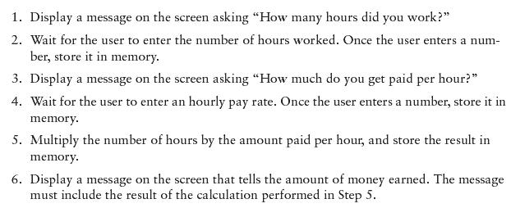
Example Algorithm for Calculating Gross Pay

Slide 26
Machine Language
Although the previous algorithm defines the steps for calculating the gross pay, it is not ready to be executed on the computer.
The computer only executes machine language instructions

Slide 27
Machine Language
Machine language instructions are binary numbers, such as
1011010000000101
Rather than writing programs in machine language, programmers use programming languages.

Slide 28
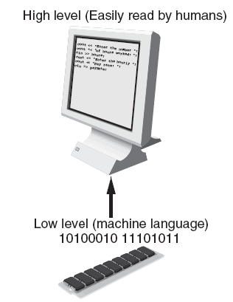
Programs and Programming Languages
Types of languages:
  Low-level: used for communication with computer hardware directly. Often written in binary machine code (0’s/1’s) directly.
  High-level: closer to human language

Slide 29
Some Well-Known Programming Languages (Table 1-1 on Page 10)
C++
BASIC
Ruby
Java
FORTRAN
Visual Basic
C#
COBOL
JavaScript
C
Python

Slide 30
From a High-Level Program to an Executable File
Create file containing the program with a text editor.
Run preprocessor to convert source file directives to source code program statements.
Run compiler to convert source program into machine instructions.
Run linker to connect hardware-specific code to machine instructions, producing an executable file.
Steps b–d are often performed by a single command or button click.
Errors detected at any step will prevent execution of following steps.

Slide 31
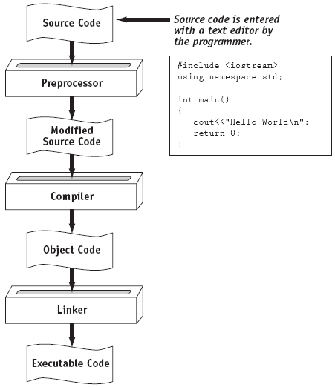
From a High-Level Program to an Executable File

Slide 32
Integrated Development Environments (IDEs)
An integrated development environment, or IDE, combine all the tools needed to write, compile, and debug a program into a single software application.
Examples are Microsoft Visual C++, Turbo C++ Explorer, CodeWarrior, etc.

Slide 33
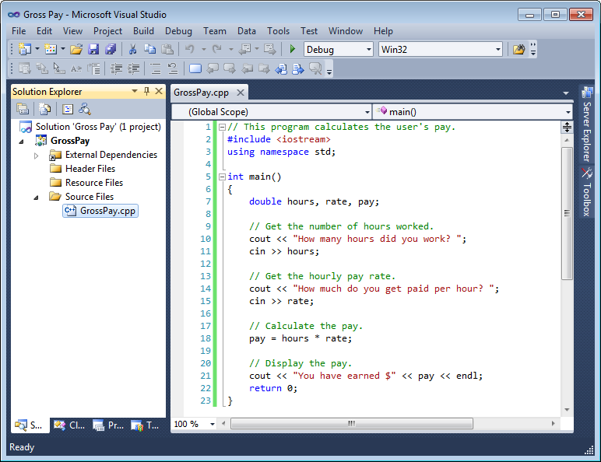
Integrated Development Environments (IDEs)

Slide 34
1.4
What is a Program Made of?

Slide 35
What is a Program Made of?
Common elements in programming languages:
  Key Words
  Programmer-Defined Identifiers
  Operators
  Punctuation
  Syntax

Slide 36
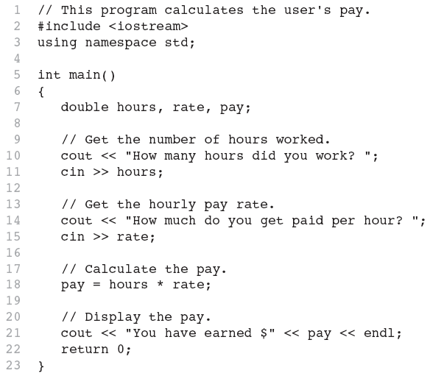
Program 1-1

Slide 37
Key Words
Also known as reserved words
Have a special meaning in C++
Can not be used for any other purpose
Key words in the Program 1-1: using, namespace, int, double, and return

Slide 38
Key Words

Slide 39
Programmer-Defined Identifiers
Names made up by the programmer
Not part of the C++ language
Used to represent various things: variables (memory locations), functions, etc.
In Program 1-1: hours, rate, and pay.

Slide 40
Operators
Used to perform operations on data
Many types of operators:
  Arithmetic - ex: +,-,*,/
  Assignment – ex: =
Some operators in Program1-1:
<< >> = *

Slide 41
Operators

Slide 42
Punctuation
Characters that mark the end of a statement, or that separate items in a list
In Program 1-1: , and ;

Slide 43
Punctuation

Slide 44
Syntax
The rules of grammar that must be followed when writing a program
Controls the use of key words, operators, programmer-defined symbols, and punctuation

Slide 45
Variables
A variable is a named storage location in the computer’s memory for holding a piece of data.
In Program 1-1 we used three variables:
  The hours variable was used to hold the hours worked
  The rate variable was used to hold the pay rate
  The pay variable was used to hold the gross pay

Slide 46
Variable Definitions
To create a variable in a program you must write a variable definition (also called a variable declaration)
Here is the statement from Program 1-1 that defines the variables:
double hours, rate, pay;

Slide 47
Variable Definitions
There are many different types of data, which you will learn about in this course.
A variable holds a specific type of data.
The variable definition specifies the type of data a variable can hold, and the variable name.

Slide 48
Variable Definitions
Once again, line 7 from Program 1-1:
double hours, rate, pay;
The word double specifies that the variables can hold double-precision floating point numbers. (You will learn more about that in Chapter 2)

Slide 49
1.5
Input, Processing, and Output

Slide 50
Input, Processing, and Output
Three steps that a program typically performs:
  Gather input data:
    from keyboard
    from files on disk drives
  Process the input data
  Display the results as output:
    send it to the screen
    write to a file

Slide 51
1.6
The Programming Process

Slide 52
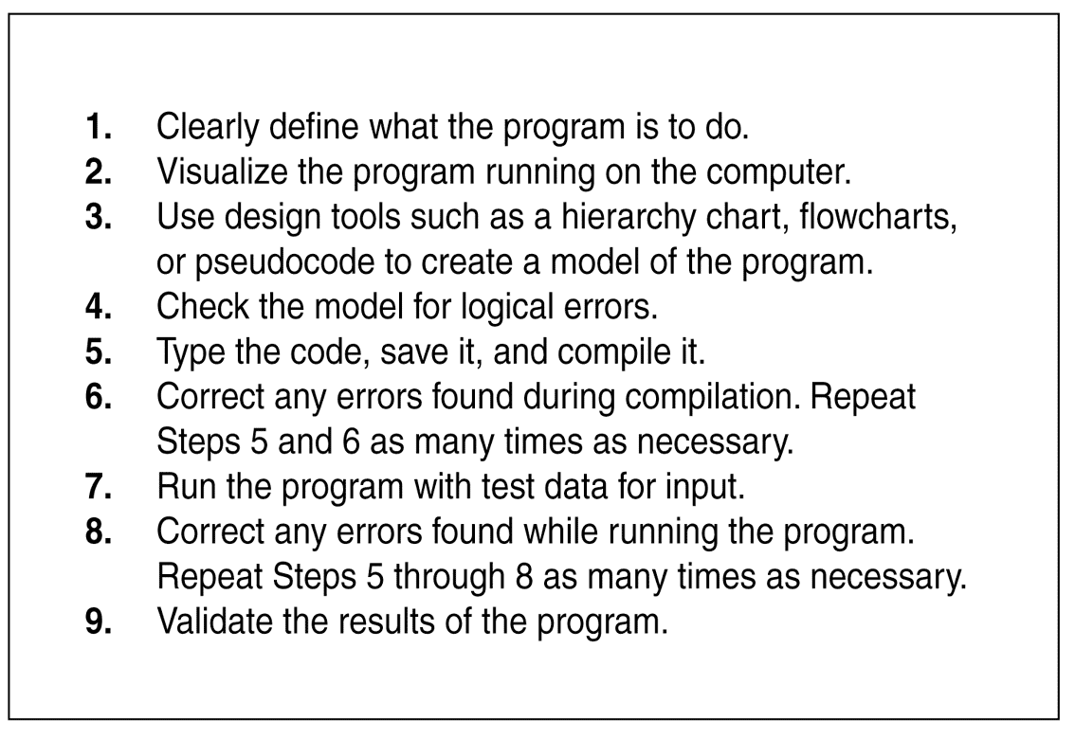
The Programming Process

Slide 53
1.7
Procedural and Object-Oriented Programming

Slide 54
Procedural and Object-Oriented Programming
Procedural programming: focus is on the process. Procedures/functions are written to process data.
Object-Oriented programming: focus is on objects, which contain data and the means to manipulate the data. Messages sent to objects to perform operations.

